Slide 1
Predicting Student Dropout using Machine Learning
Authors:
Marina Reda Abdullah
Aly Maher Abdelfattah
Hamza Nashaat Abdelbaki
Mohamed Ahmed Fathi
Omar Adly Mahmoud Nasr
Instructor: Dr. Mohamed Abd Elaziz

Slide 2
Objectives
Develop accurate models to predict student dropouts.
Analyze factors influencing student attrition.
Provide actionable insights for educational institutions.
Improve student success and academic achievement.
Demonstrate the efficacy of data-driven approaches.

Slide 3
Introduction
Education plays a crucial role in individual and societal development.
Student dropout disrupts education and has long-term consequences.
This project uses machine learning to predict and prevent student dropouts.

Slide 4

Data Collection and Preprocessing
Data sourced from kaggle.
Includes academic performance, socio-demographic information, and behavior.
Missing values handled, categorical data encoded, and data shuffled.
Class imbalance addressed using SMOTE technique.

Slide 5
System Analysis and Design
Architecture includes data collection, preprocessing, feature selection, model development, and evaluation.
RandomForestClassifier, AdaBoostClassifier, and GradientBoostingClassifier used for modeling.
Python, sklearn-learn, seaborn, matplotlib, and imbalanced-learn libraries used.
Data flow from input to model evaluation follows a sequential process.

Slide 6
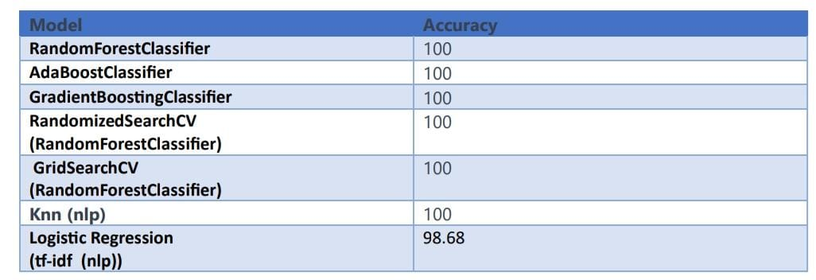
Implementation and Outputs
Models trained and evaluated on preprocessed data.
Accuracy, precision, recall, and F1-score calculated.
Insights into factors influencing student dropout provided.
Comparative analysis of model performance conducted.

Slide 7
Conclusion
Machine learning models successfully predict student dropouts.
Data analysis reveals key factors influencing attrition.
Actionable insights for educational institutions generated.
Early intervention can improve student retention and success.
Data-driven decision-making crucial for education.

Slide 8
THANK YOU

